Slide 1


APK 6725 AI for Sports and Movement Sciences
Introduction to Python

Slide 2
Introduction to Python
What is Python?
Python is a VERY popular high-level programming language. Python is well suited for rapid prototyping.
Why Python?
Python is now the default programming language for data science applications. Python and its many libraries are used in thousands of data science projects. Everyone, from students to billion-dollar corporations, use Python.

Slide 3
Introduction to Python
How to use Python?
There are different ways to use Python, these include:
Locally (install Python in your machine)
In the cloud (Run python in an external server)
Using services such as HiperGator, Google Collaboratory, or Digital Ocean
Hiring a computer stored in a data center and accessing it via SSH

Slide 4
Introduction to Python
How to use Python locally?
The easiest (in my opinion) way to install Python is via anaconda.
To get started, visit
https://www.anaconda.com/download/success
Find your operating system (Windows or Mac) and download the Graphical Installer.

Slide 5
Introduction to Python
How to use Python locally?
Note: The following steps will install a large program in your computer. This is not needed to use Python; it is just convenient.
If you don’t want to install this large program, you can install Miniconda and then type in the terminal
>> conda install numpy pandas scikit-learn matplotlib seaborn jupyter
Afterwards, you will be all set to start working on your assignments.

Slide 6
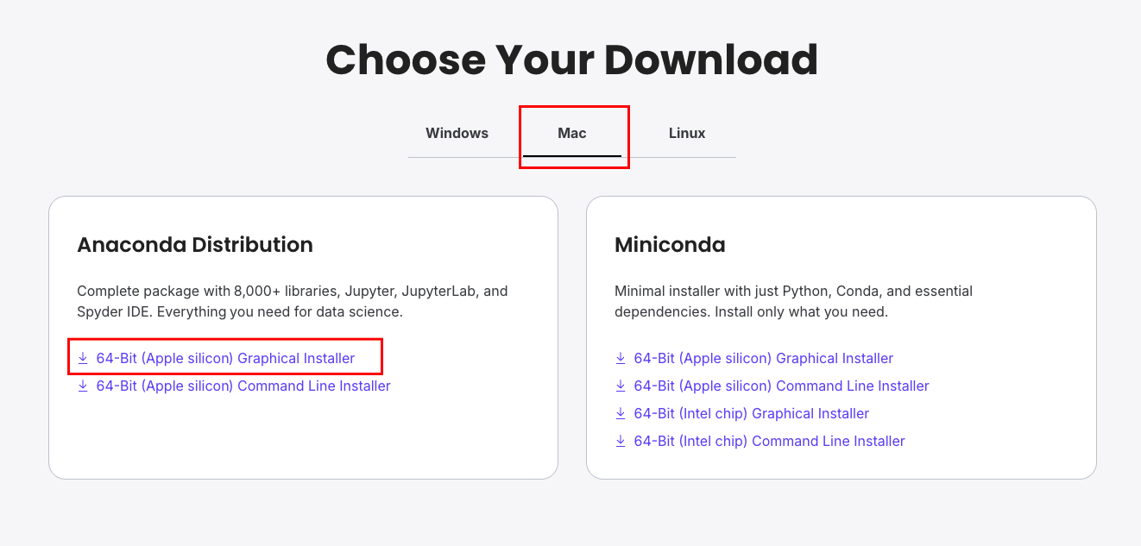
Introduction to Python
How to use Python locally?

Slide 7
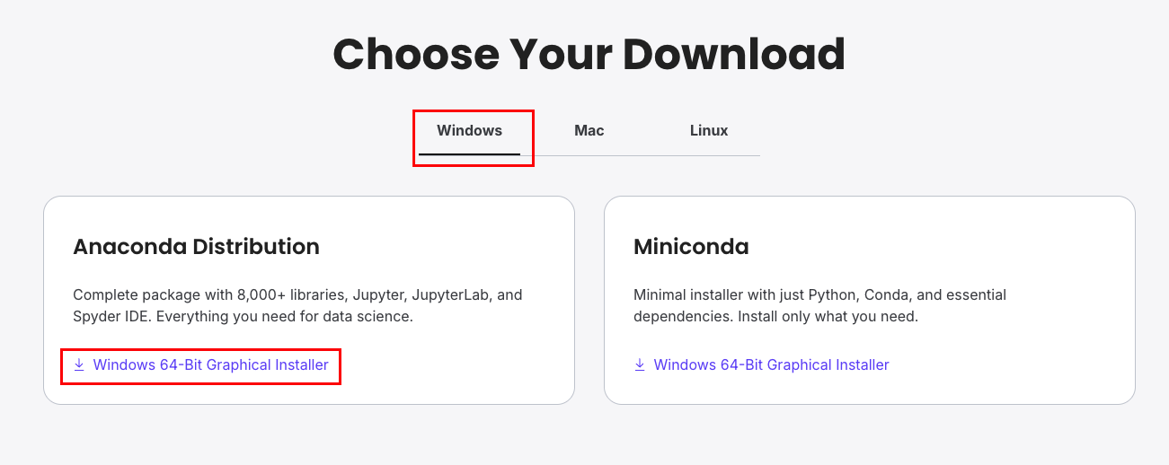
Introduction to Python
How to use Python locally?

Slide 8
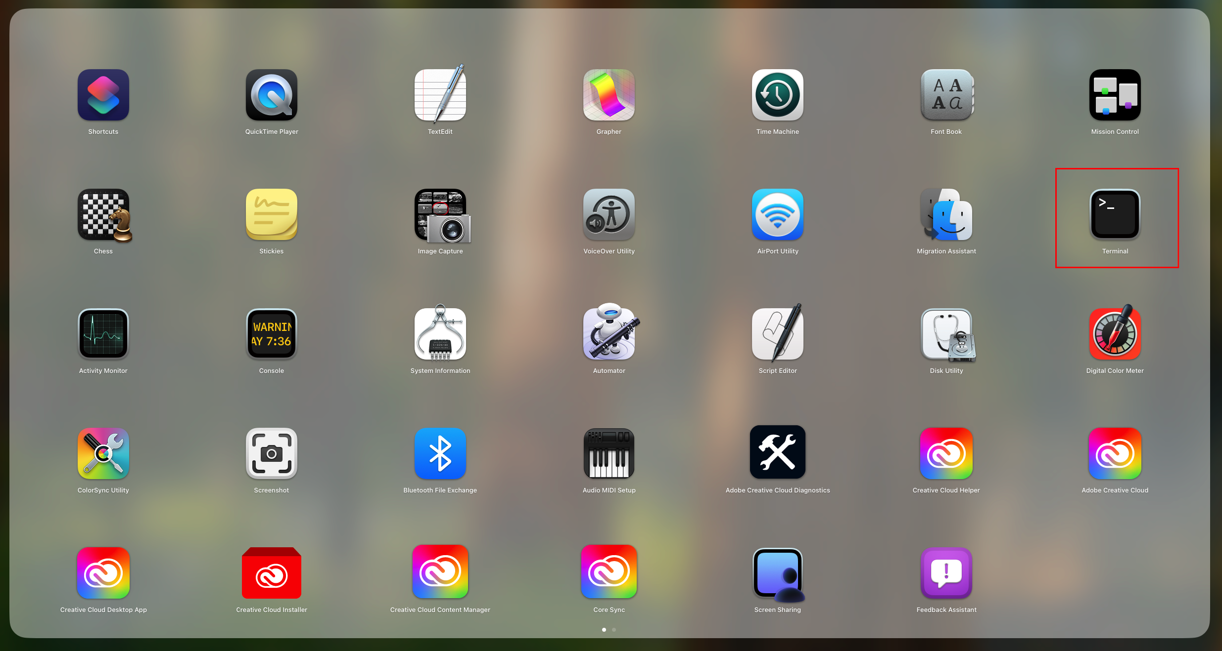
Introduction to Python
How to use Python locally?
After installing anaconda on your computer, find :
For Mac -> Terminal

Slide 9
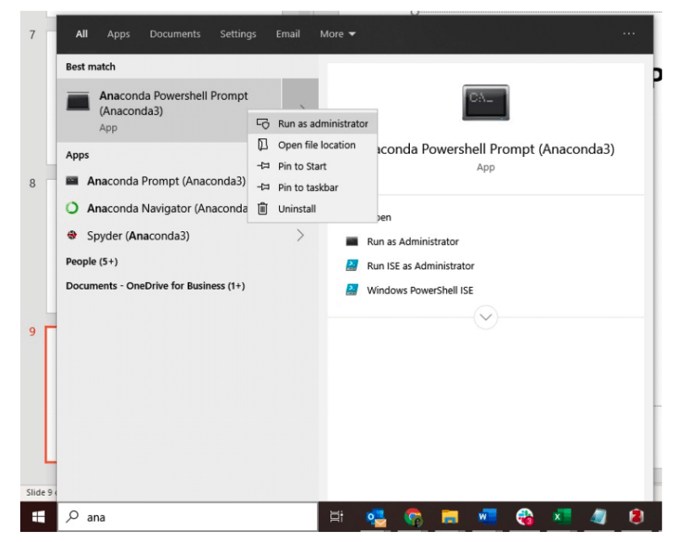
Introduction to Python
How to use Python locally?
After installing anaconda on your computer, find :
For Windows -> Anaconda Power Shell -> Run as Administrator

Slide 10
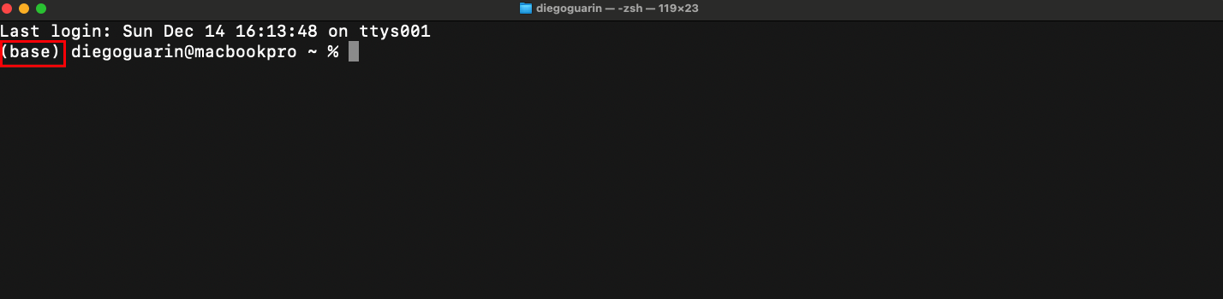
Introduction to Python
How to use Python locally?
You should see something like this:

Slide 11
Introduction to Python
How to use Python locally?
Create a new folder where you will store all your code, for example
\Documents\AIforMovementSciences\
And navigate to that folder in the terminal window.
Note-> avoid using spaces in the folder’s name, for example, “AI for Movement Sciences” should be “AIforMovementSciences”

Slide 12
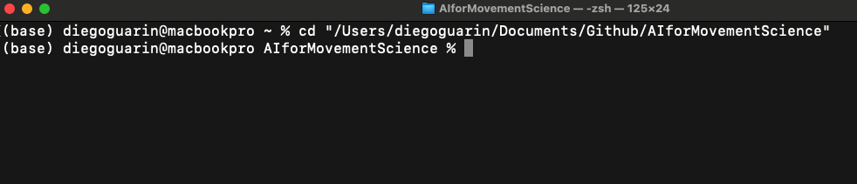
Introduction to Python
How to use Python locally?
Go to the folder in the Terminal using the ‘cd’ command

Slide 13
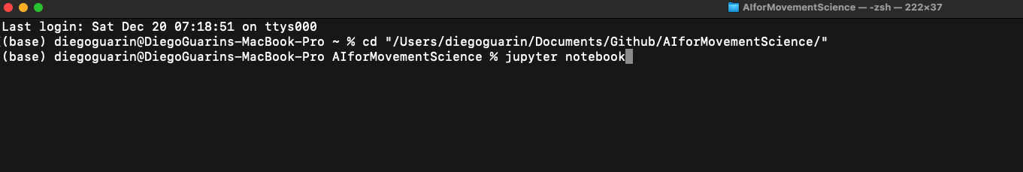
Introduction to Python
How to use Python locally?
Type ‘jupyter notebook’ in the terminal and press Enter

Slide 14
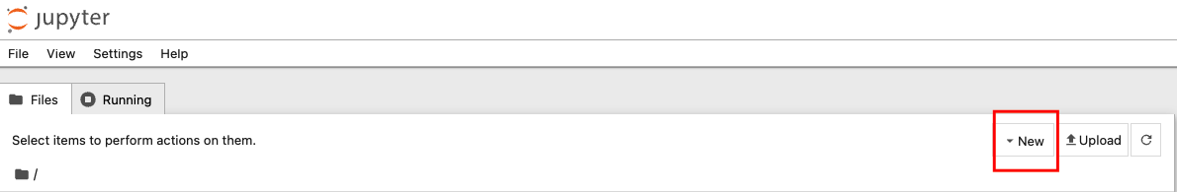
Introduction to Python
How to use Python locally?
This action will open a new browser window that allows you to create new Jupyter Notebook

Slide 15
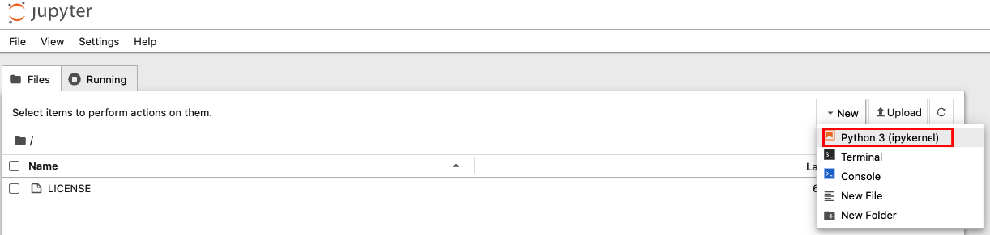
Introduction to Python
How to use Python locally?
Click on New -> Python 3

Slide 16
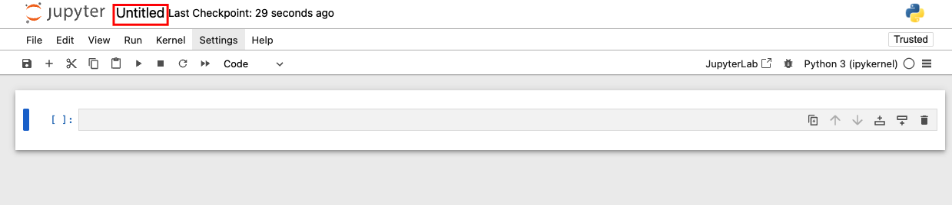
Introduction to Python
How to use Python locally?
A new browser tab will open with the Jupyter Notebook.
Click on Untitled and change the file name, for instance, to “Example”

Slide 17
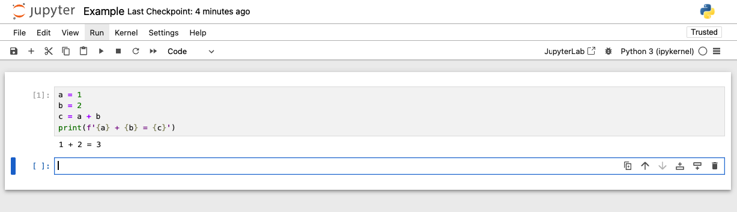
Introduction to Python
How to use Python locally?
You are now ready to start working with Python using Jupyter Notebooks.

Slide 18
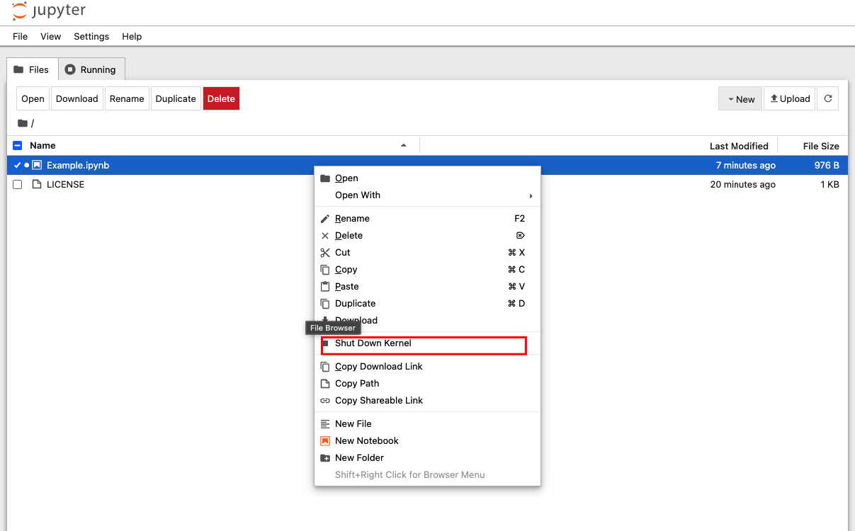
Introduction to Python
How to use Python locally?
Always shut down your Jupyter Notebooks (especially if you have GPU).

Slide 19
Introduction to Python
How to use Python locally?
Jupyter Notebooks is an Integrated Development Environment (IDE) that helps you run and visualize your Python code. But Jupyter Notebook files (.ipynb) are not pure Python.
Most people in data science will use Jupyter Notebooks, so it is easy to share information and code. However, people in other fields won’t know what Notebooks are, and will ask for a Python (.py) file with your code.

Slide 20
Introduction to Python
How to use Python locally?
Disclaimer:
I personally don’t use Jupyter Notebook directly, rather, I use another IDE called VSCode, which is nicely integrated with many other tools.
You can ‘graduate’ to VSCode once you are comfortable with Jupyter Notebooks.

Slide 21
Introduction to Python
How to use Python in the cloud?
The easiest approach is to use Google Colab. It is a free (with limitations) service to run Jupyter Notebooks
https://colab.research.google.com/
We will use Google Colab in the class, you should be able to complete all the class activities within this environment.

Slide 22

Introduction to Python
How to use Python in the cloud?
To access YOUR personal Google Drive, you must execute the following code at the beginning of each session
Google Colab Notebooks are shut down automatically after some period of inactivity. Remember to save your progress.

Slide 23
Introduction to Python
How to use Python in the cloud?
Another approach is to use UF’s HiperGator.
There are several tutorials online how to access Jupyter Notebooks using HiperGator so we won’t cover this topic in class.

Slide 24
Introduction to Python
How to use Python in the cloud?
Finally, you can rent a Virtual Machine in AWS or GCloud and have a personal computer in the cloud that you can access via SSH.
You can rent a computer with the latest GPUs for a few cents per hour, making this the most cost-effective solution for large scale machine learning projects.

